Slide 1

COMPUTER AIDED DESIGN AND DRAFTING [Q]
Supervisor : DR. MD. MAHADI HASAN

Slide 2
Outline
1. Objectives
2. Introduction
3. Fittings and Fixture Layout
4. Important tools
5. Civil planning
6. Procedure
7. Discussion
8.Conclusion

Slide 3
A Civil Plan of a Hospital

Slide 4






Objectives
Comprehensive and accurate representation.
To enable adaptability and flexibility in design.
Enhances project understanding.

Slide 5
.
Introduction
Serves as the foundational blueprint for translating the vision of a civil engineering project .
Graphical representation.
Civil drawing is a crucial aspect of civil engineering.
Communicate engineering information visually.
Designing a civil plan for a hospital is a meticulous and critical process that requires careful consideration of both functionality and spatial efficiency.

Slide 6
Fittings and Fixture Layout
Switchboard Placement
Lighting and Fan Allocation
Exhaust Fans
Switched Socket Outlets
Television Connectivity
Calling Bell set up
SDB and MDB positioning

Slide 7
Important tools
Drawing Toolbar
1.Line
2. Text
3.Circle
4.Text
5.Arc
6. Rectangle
7. Hatch
Modify Toolbar
1.Trim
2. Move
3. Erase
4.Mirror
5.Offset
6.Rotate

Slide 8
Useful commands
1.Unit
2.Dimensions
3.Limit
4. Drafting Setting
Set up
1. Unit (Inches) select.
2. Drawing limit
3. Change dimensions.
4. Layer set up

Slide 9
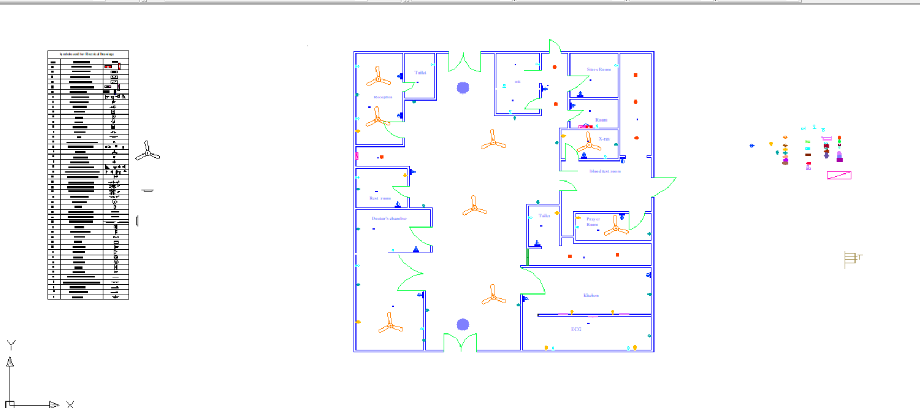

Slide 10
Procedure

Slide 11
• Open AutoCAD 2007 and start a new drawing.
• Set the units to the appropriate scale (e.g., feet).
• Use the "Rectangle" tool to draw the outer walls of the hospital. Ensure the total area is approximately 8000 square feet.
• Use the "Line" tool to create internal walls to divide the space into rooms.
• Designate areas for at least 10 rooms. Consider including offices for employees, staff rooms, a kitchen, toilets, and a prayer room. Use the "Rectangle" tool to outline each room.
•Label each room with its purpose, e.g., "Employee Room 1," "Staff Room 1," "Kitchen," "Toilets," and "Prayer Room."

Slide 12
• Add dimensions to define the size of rooms and distances between objects. Use the "Dimension" tool for accurate measurements.
• Ensure that the plan complies with local building codes and regulations.
• Divide the building into rooms using the LINE and OFFSET commands.
• Assign objects to appropriate layers for better control and organization.

Slide 13
Discussion
precautions
Errors
Use layers properly.
Double-check before finalizing.
Be mindful of precision.
Check the drawing Units and Scale.
Drawing at the wrong scale.
Ignoring units settings in AutoCAD.
Allowing an uncontrolled increase in the number of layers.
Neglecting Annotation Standards.

Slide 14
Conclusion
In essence, civil drawing is a visual language that facilitates the planning, communication, and execution of complex construction projects, contributing significantly to the success and efficiency of the entire engineering process.
At the end, creating a civil plan for a hospital with approximately 8000 square feet of space using AutoCAD 2007 involves meticulous planning and attention to detail. The design must consider the specific needs of the facility, including at least 10 rooms for employees and staff, a kitchen, toilets, and a prayer room. Throughout the process, adherence to local building codes, regulations, and healthcare standards is crucial to ensure a safe and functional environment.

Slide 15
THANK YOU

